Slide 1
Introduction to Data Science In R
Pat Callahan
UCSF Memory and Aging Center
8/18/2020
Notes:
Everyone is going to be on mute by default
Feel free to ask questions in the chat, and please note the slide # that your question pertains to.
Pat Callahan, CRC with the Rankin lab coming up on 2 years. Have done lots of work with coding in R, and today we’re going to take a look at R in the context of data science and do an intro
Assumptions: some familiarity with R at minimum. The presentation today won’t necessarily be as practical as the Tidyverse presentation from last week, but it will include technical details ranging from very basic, beginner topics up to more intermediate issues and troubleshooting steps.
There’s a lot of content I’m going to try to cover, and I really don’t expect everyone to completely understand everything the first time around.
My recommendation: take note of what you don’t understand, ask questions after the presentation, and Google some of the topics.
My overarching goal is to introduce difficult topics in a concise, contextualized manner so you know where to go in the future.
So what will we cover today?

Slide 2
Presentation Overview
R and Data Science
Quick Start Guide
ImpoRtant Topics
Notes:
Goals
My presentation today is to briefly make the case for why you should be using R when it comes to data science and analysis
I’ll give a quick start guide on basic, tangible things you’ll need to do in R
From there, I’ll be covering a variety of topics that will help you better use and understand the R language
My goal is not to give you all of the information on every topic; there’s simply too much to cover, and so I want to do what I can to tie together a lot of these disparate topics into a cohesive story about R and how to use it
More of a starter pack of topics I find to be of practical use
Some of the technical details I’ll give you are half-truths or white lies, and I’ll do my best to let you know when something is a rule vs. an expectation

Slide 3
R and Data Science
Notes:
Data science is a massive, kind of amorphous field that I think can very broadly be thought of as the cross-section of math/statistics, domain expertise, and coding
Math/statistics is a bit of a nebulous term, but it’s more relatable if you think of it in terms of things like frequentist or Bayesian statistics, and model building.
Even if that’s not the case, I think there’s a lot of great mentorship available about the MAC regarding what kinds of statistical approaches to take, and how to learn about those.
Domain expertise: many of you here today are or will be experts in certain realms of neuroscience and neurodegeneration! I, and hopefully others, trust that you have the knowledge to make empirically-informed models and conclusions. I won’t be able to teach much here.
I think there's a lot of domain and statistics expertise at the MAC to draw from, and some really powerful things can be accomplished from that
The final step is coding skill!
The coding aspect of data science, however, is where I can provide some input today and assist in answering various questions. What language does everyone else use? What language should I use? How do I start learning a language? What are the best resources? How do I get things done quickly?
So beginning with R and Data Science, let’s first glance at R’s history

Slide 4
R History
Implementation of the S language
Authors: Ihaka and Gentleman
Initial 1.0 release in February 2000
Reached 4.0.0 in April
Purpose-built as an open-source statistical analysis tool
Notes:
R is mostly derived from the S language, and was developed by Ross Ihaka and Robert Gentleman at the University of Auckland, NZ
First complete release was early 2000, and the latest milestone was reached just back in April as R reached it’s 4th major iteration
Depending on context: it’s old, it’s new, it’s mid-life
At this point, I’d just say that it’s well-established and maintained
When being developed by Ihaka and Gentleman, it was explicitly made as an open-source statistical analysis tool to address what they saw as a shortcoming in this aspect of the research world
There’s are, therefore, pros and cons to the ethos of the R language, and lets start with some of the cons

Slide 5
R Cons
Technical debt and code oddities
Derived from S, C, and FORTRAN
Obtuse error messages
Ugly base graphics
A maze of open source packages
Steep learning curve
Notes:
Mentioned it’s primarily derived from the S language, but also implements C and FORTRAN. The details here don’t matter except for the fact that operations under-the-hood for R are an amalgamation of languages, and it produces some technical debt—updates can be slow
Hand-in-hand with this technical debt is the fact that some of the error messages are, frankly, obtuse. Even today, I often struggle to really understand error messages that are produced at a low-level and in Base R.
Graphic design has come a long way in 2 decades so base graphics are ugly, and customization is poor.
Blessing and a curse: options. So many options when it comes to packages.
When it comes to data preparation and visualization, I emphatically recommend the Tidyverse which was the topic of last week’s presentation. I’d strongly encourage you to check out that video if data prep and viz is your primary concern right now.
Biggest problem I come across is that some R fundamentals have a steep learning curve. I encountered this myself when learning R, and I hope

Slide 6
Alternatives
Python
MATLAB
SPSS
Julia
SAS
Notes:
If any of those cons are a dealbreaker, here are some common alternatives particularly within academia
SPSS has been the most popular language for the last 2 decades followed by R
SAS in a far 3rd, followed by MATLAB then everything else
Python good because it’s a common general-purpose language, and has good data science libraries
Julia is the upstart language that could be really big in 10 years—strong emphasis on execution speed
Let’s go to the positives, which I think far outweigh the downsides of R

Slide 7
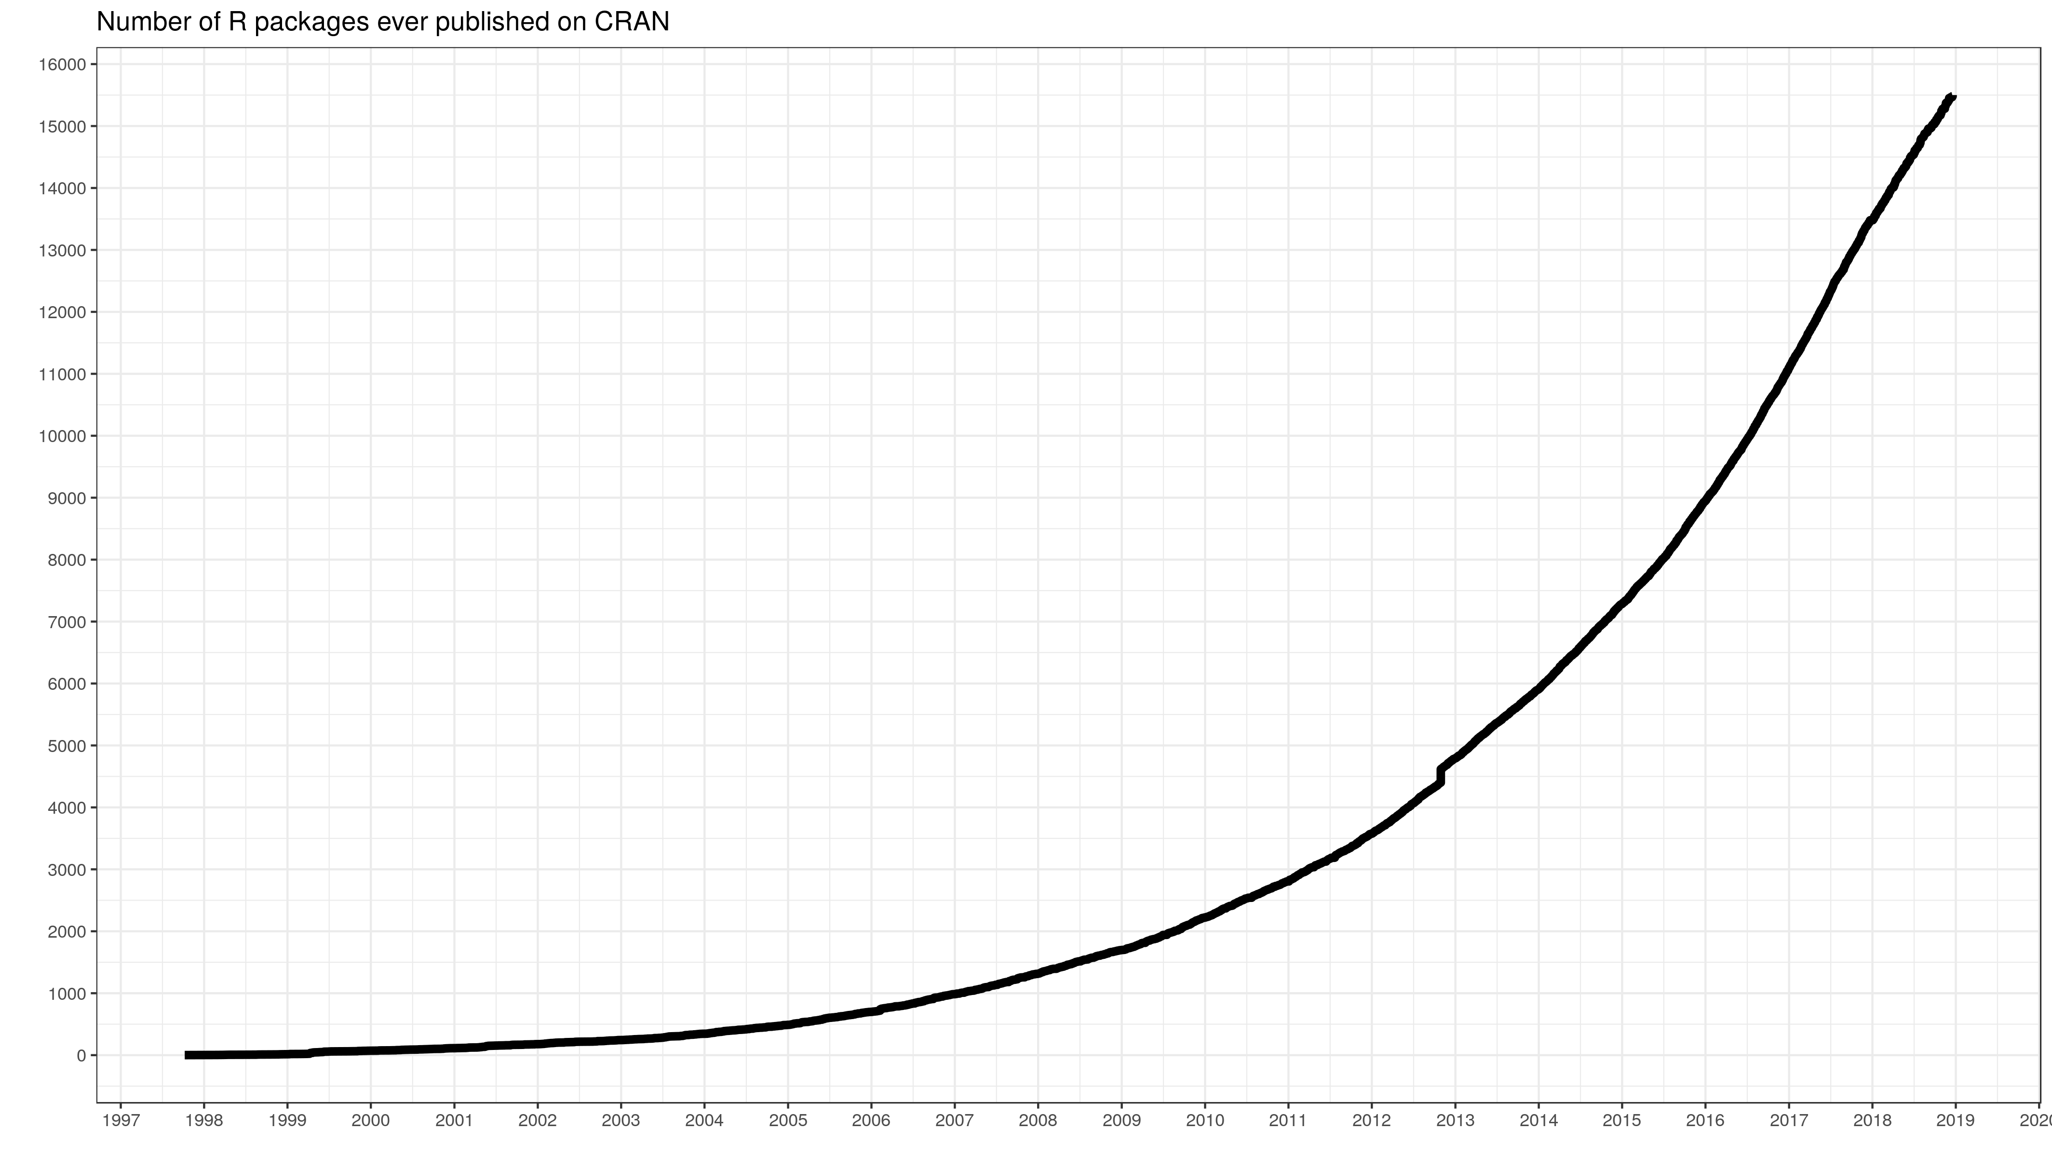
R Pros
Free, now and always!
Documentation and help networks
Stack Overflow, RStudio Community, GitHub, etc.
Standard in research and data science jobs
Widely-taught in universities
Current and future colleagues will know R
Open source packages
>15,000 on CRAN
Notes:
SAS, Stata, SPSS, and MATLAB all cost money, but R is free!
Excellent documentation network; 99% of all questions I’ve ever had about R have already been answered online
Standard in most research or data science jobs
Many universities transitioning to it over MATLAB due to cost and open research initiatives
Anecdote: Berkeley data science courses are now all R, and Berkeley is the largest pipeline of CRCs here
My university actively made the switch while I was a student as well
Package growth from 2000 to 2019, and the breadth of packages is incredible
Everything from QR code generators, to website generators, to machine learning and big data outsourcing packages.
More importantly, these packages enable massive flexibility when performance is an issue. You can outsource your functions to SQL, Python, C++, and other languages if something absolutely must be done faster than R can manage. This flexibility isn’t really available in any of the preceding languages
So these are the pros of R. Now, what would be of interest to everyone here as researchers?

Slide 8
Analysis with R
Descriptive and inferential statistics
{stats}, {psych}, {summarytools}
Machine learning
{mlr}*, {caret}, {nlme}
Big data processing
Apache Spark and Hadoop interfaces
Notes:
You should use R largely because it has packages for basically any analysis technique you’ve ever seen implemented
Functions for descriptive stats such as measures of central tendency, dispersion, and skewness are built into the stats package alongside standard inferential approaches like hypothesis testing, regression models, general linear models, and other population estimates
Psych package extends this to common psych analyses I know are performed at the MAC such as PCA, item response theory, cluster analysis, and more
Haven’t validated {summarytools} myself, but people seem to like some of the summary functions—wraps the {stats} package nicely
Machine learning techniques
{mlr} is the only one I’m directly familiar with, and I’m a big fan. Covers all of the major classification and unsupervised learning techniques you might be interested in: kNN, random forests, survival analysis, and so much more with clear methods for hyperparameter tuning
Technically a deprecated package
{caret} seems to be the other major ML package
{nlme} is included here because it’s a linear mixed effects models package, and these analyses seem to come up frequently at the MAC (beyond basic GLMs)
Big data processing
Probably not super applicable unless you’re working with massive datasets like with genetics or some sort of large-scale neuroimaging work
Packages to interface with things like Apache Spark, Hadoop, and Storm if you find yourself dealing with huge amounts of data that cannot reasonably be processed in RAM on your system
Don’t worry if you’re not familiar with these—they’re not super applicable to research
This concludes the section on R as a data science tool. I hope that you’re now wondering how to actually use R, and as such we’ll move on to the Quick Start guide

Slide 9
R Quick Start
Notes:
What to download
How to open and use those tools

Slide 10
Getting Started with R
Download R from the R Project website
Optional: download Xcode (Mac) or {rtools} (PC)
Needed for compiling some R packages
Download RStudio interactive development environment
Technically optional
Notes:
To get started, you’ll need to download R! Available at the R Project website, can google “download R”, or can open the link in this slide if you check out these slides on my GitHub after the presentation
If you’re on a Mac I recommend downloading Xcode, and downloading Rtools if you’re on a PC
These softwares are for compiling some R packages that use C/C++/FORTRAN. Don’t worry about the details
Next most important step after downloading R is downloading RStudio which is an IDE or interactive development environment.
This is technically optional, but this IDE is a massive improvement over the base R tool. The only time I bring up the original R program is when I do it accidentally
The IDE lets you interactively write, run, and edit your code in an easily viewable environment
Will show you what that environment looks like so we can quickly become familiar with it!

Slide 11
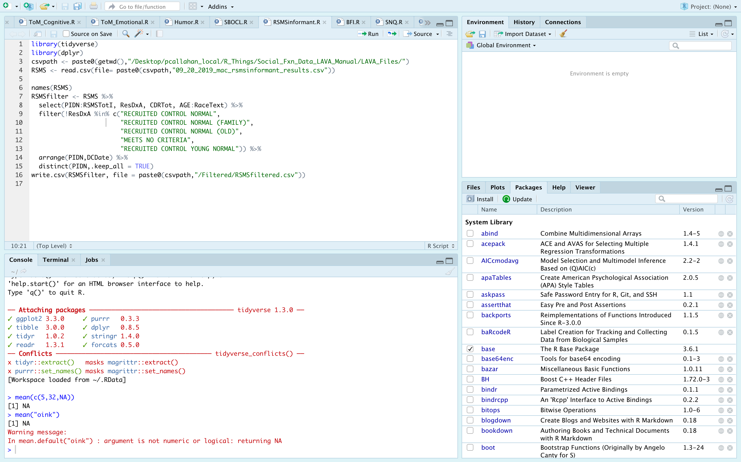
Notes:
Appearance of RStudio. You can ignore any specific text for now—I want to point out the 4 major panes…
Four sections typically referred to as: source, environment, console, and viewer/help window
If you look closely, you’ll see that each of these panes have multiple tabs. I’ll discuss each tab generally, but the tabs currently open are the most commonly used.
Source: contains all of your open .R and .Rmd files. Can run the entire script by pressing the Source button, or run line-by-line with Run
Environment: shows all objects in your environment. In this case, I have no objects saved to my env!
History: shows the history of the lines you’ve run in this session
Connections: if you connect to a database a la a SQL connection
Console: shows the code you just ran, and prints out the results of that code
Terminal: you can run bash or shell commands here
Jobs: tells you what, if anything, is running in RStudio. I never use this.
Viewer/helper
Packages: shows you all of the packages you’ve downloaded and options to install/update
Files: shows you the files available in your current working directory
Plots: will show you any plots that you’ve generated using R during this session.
Help: frame that pops up when you call for help on a function. I’ll cover this later in the talk
Viewer: opens various R objects that aren’t plots or help files. Won’t be covered—separate topic

Slide 12
R Scripts and RMarkdown
R Script files
Write executable code
.R extension
RMarkdown files
Interweave code and text
Report writing
.Rmd extension
Notes:
I mentioned R scripts and RMarkdown files in the previous slide, so what are those?
Files where you can write executable code
R Scripts are really just for writing code and maybe having some notes to go with your code. Ends with the .R extension
The RMarkdown files are meant for you to interweave code and text into a report. Ends with .Rmd extension

Slide 13
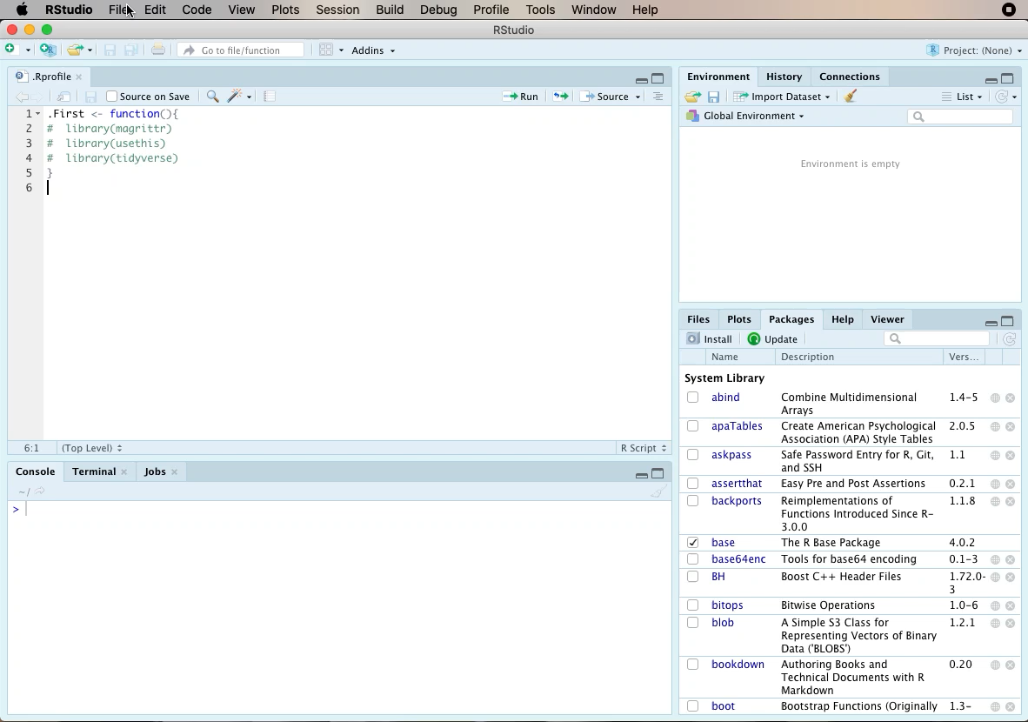
R Scripts and RMarkdown
Notes:
90 second tutorial on opening and using these document types
First, we’ll open a new R Script in RStudio
In the script, we can load a package then write and run some code.
Results displayed in the Console at the bottom
Second, we create a new Rmarkdown document
We title the document however we please
Note that there are 3 different output formats which is a great thing when it comes to flexibility and how you want to publish your documents
Title in the new document reflects the title we selected
Notice that there are these greyed-out chunks, which are sections for you to write your code
The white space in-between is where you can write text using Markdown formatting
Finally, you can “knit” this document to the document type we specified earlier, an HTML, and we end up with this neat document that contains all of our source code, code output, and text wrapped together.

Slide 14
ImpoRtant Topics
Syntax
Infix Operators
Classes
Functions
Loops
Data tables
Notes:
This is going to be both the bulk of the presentation and the more advanced portion of the presentation, but will also provide more tangible information on R
Going to cover a ton of topics here, and I hope that you learn a handful of things, have some questions, and work to answer those questions outside of this presentation.
Regardless, I think everyone who uses R or is planning to use it should still get some good information out of it
I’ll be covering a range of basic topics like troubleshooting up to some more programmatic discussions
I’ll give an overview of:
R Syntax
R Infix operators
R classes and hierarchy
Functions
Loops
Data structures
These are some of the most essential things you should know about in R from a practical standpoint
Close out with troubleshooting and help tips

Slide 15
Syntax

Slide 16
Simple Syntax
Object assignment: <- OR =
Function calls: foo(x, …)
Annotations/notes: # your note
Reserved namespaces
TRUE, FALSE, if, else, NA, NULL, arithmetic operators
Objects beginning with numbers or _
Case sensitive language
Notes:
Ok so I’ve shown you how to create R files, and I presume you’ll also want to know how to write some code!
There are, of course, some guidelines on how to write code
Well, that’s defined by R’s syntax rules, and here are the most essential, basic rules
You can create or assign an object with <= or =
<= is preferred
You can call functions
Function name, and all of your arguments between a set of parentheses
You can write annotations/notes with the hashtag/octothorpe
There are reserved names that you can’t use for anything!
Last point to know is that R is case sensitive when you’re assigning objects
So what does some of this really basic syntax look like in action?

Slide 17
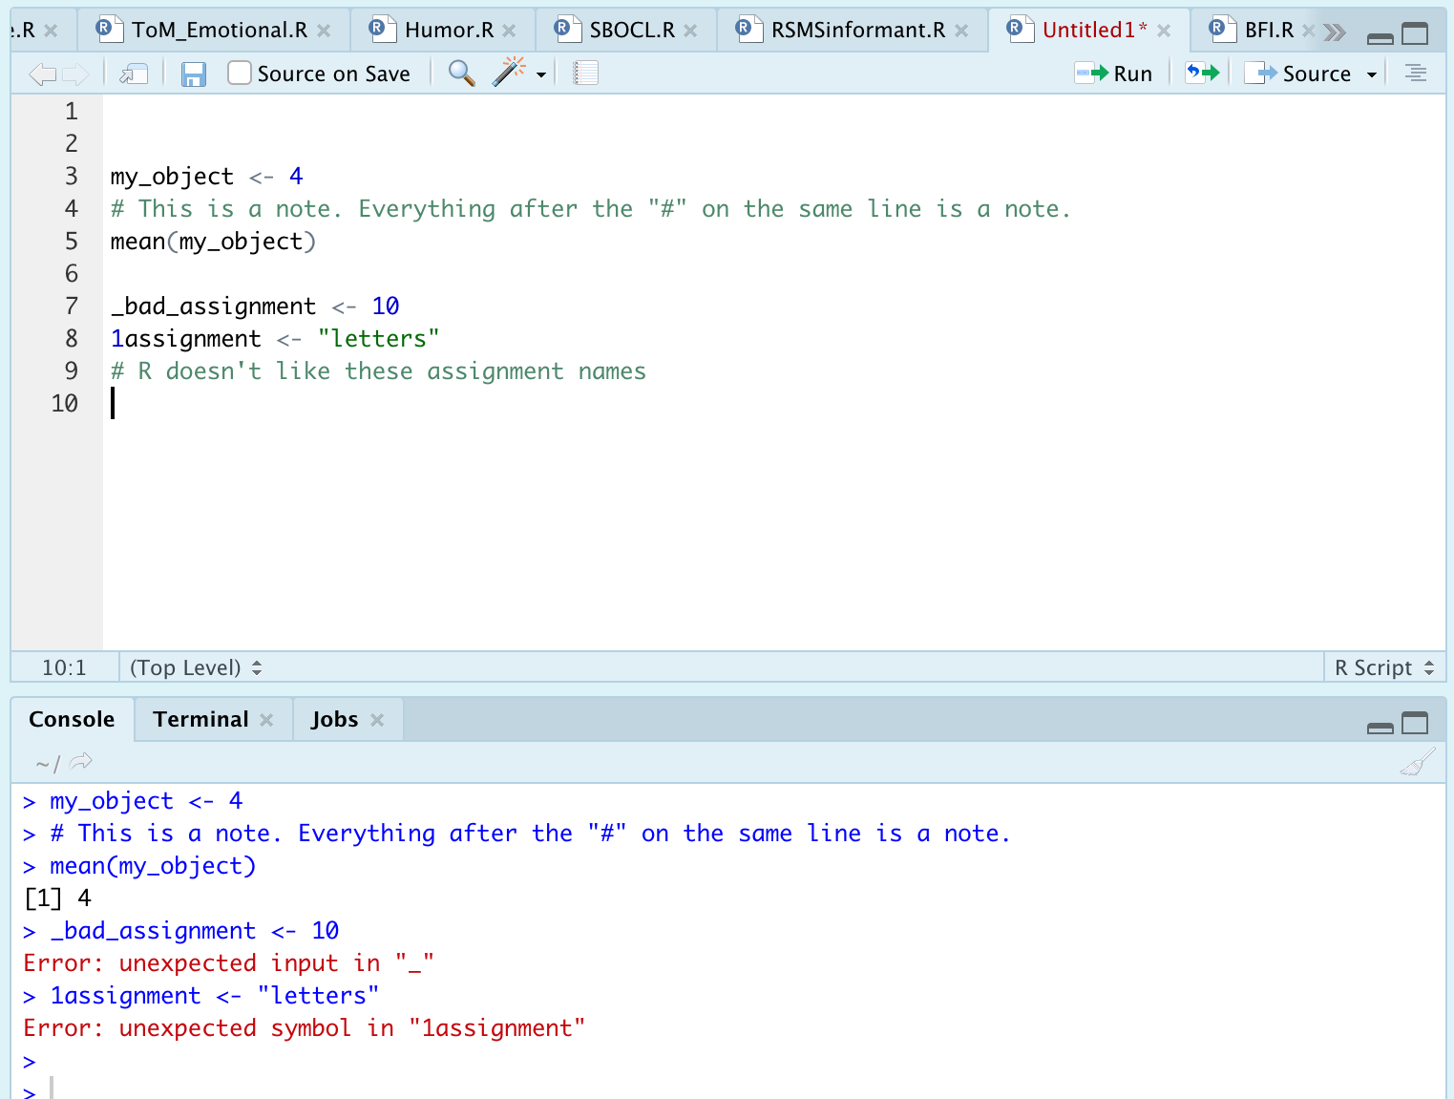
Simple Syntax
Notes:
First line shows simple object assignment, in this case assigning the value of 4 to the variable I made called “my_object”
Next is a line demonstrating a comment
Following that is wrapping a function around the object I defined “my_object.” Unsurprisingly, the mean of 4 is…4!
The latter two lines, 7 and 8, are examples of bad operator assignment. You can see the two error messages in red printed down in the console
This is an absolute barebones minimum intro to R syntax, but I think it’s at least enough to start playing around

Slide 18
Infix Operators
Notes:
So now that we’ve covered some really basic syntax, I want to introduce you to some of the basic operations that you can do in R which rely on infix operators

Slide 19
Infix Operators
Functions/methods enabling basic expressions
“Infix” refers to placement of operators
Infix operators
+, -, *, /, ^, >, <, >=, <=, ==, &, |
Notes:
What are infix operators?
The simplest operations, like basic arithmetic, can be accomplished with infix operators which are functions/methods enabling basic expressions
The term “infix” comes from the placement of these operators between variables
Essential operators listed here, and a more complete list is available at the link

Slide 20
Booleans
Booleans represent logical values
FALSE or TRUE, NO or YES
R represents booleans numerically, 0 or 1
Done invisibly, but you can perform calculations with boolean values
Notes:
This is a special topic that goes hand-in-hand with infix operators, booleans!
(slide notes)
How do these go with infix operators? Well a lot of those operators are for comparions like greater than, less than, equals to, and so on. The result you get from those operations are TRUES/FALSES or booleans so it’s worth understanding how R treates booleans
If I write code that says 5 == 4, the result will be FALSE. Super simple example

Slide 21
Classes
Notes:
Let’s move on to one of the really essential topics of today, which is classes in R

Slide 22
Object Classes: Data Types
What is a class?
Underlying object information
Determines how functions treat the object
Why do they matter?
Running functions and troubleshooting!
What are the core data types?
Logical, (double, integer), character, complex, raw
Notes:
Classes are basically bits of information that describe any sort of objects you have in R, and the class of an object determines what a function can or cannot do with the object
For example, I can’t use a function to find the average of a word. That just doesn’t make sense--they’re totally different types of data
So classes really matter when it comes to running your functions and troubleshooting issues you migth be having
The core data types you’ll see then are:
Double and integer can actually be further grouped into a single parent class called numeric

Slide 23
Logicals
Essentially another name for booleans
TRUE/FALSE value
Can use T/F as shortcuts
Stored as integers internally
0 = FALSE, 1 = TRUE
Notes:
Pretty much another term for booleans
Like booleans, everything is stored as a TRUE/FALSE
And everything is stored internally as a 0/1 so you can do math with logicals

Slide 24
Numeric: Doubles and Integers
General name for integer and double
Difference between integer and double only apparent with processing speeds
Integers can be declared by typing “L”
Ex: 10 vs. 10L
Notes:
Numeric is the parent class for integer and double
You’ll see all three, but at the end of the day they’re all just numbers of some sort
Difference between integers and doubles is only going to be apparent with processing speeds
If you need to, you can see integers declared explicitly with an L at the end of the number
You might see this sometimes in older tutorials and troubleshooting guides
Has fallen by the wayside due to advances in computing power—no one really cares anymore

Slide 25
Characters
Alphanumeric values (i.e. strings)
Numbers alone usually recognized as numeric
Numbers with letters will be set as characters
Can use string manipulation methods on characters
Grep() functions and {stringr} package
Cannot perform mathematical operations on characters
Obvious, but also a useful troubleshooting tool
Notes:
Characters are just strings of letters, words, and other characters (or alphanumeric values)
Numbers mixed with letters are registered as characters too
What can you do with strings? You can use string manipulation methods on characters to extract, edit, substitute, or search for certain combinations of letters and words
Useful if you’re doing some sort of text processing, for example
Unsurprisingly, you can’t perform math operations directly on characters
I make this point only because it can be a useful reminder to check that, when trying to perform some math operation, you are actually passing numbers to your function
So how do all of these data types fit with one another?

Slide 26
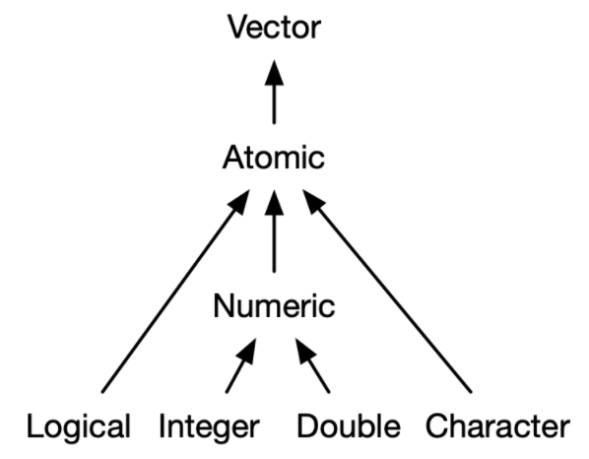
Atomic Hierarchy
Most
specific
Least
specific
Notes:
Let’s take a look at the hierarchy
You’ll see the 4 major types of data that I mentioned all listed below, and you’ll see that they all coalesce to this thing called atomic which then goes on to a vector
Everyone should now know the terms listed below, and some of you are probably familiar with a vector. In summary, a vector is basically a sequence of objects where all of the elements are of the same type
That last part I mentioned, that everything is of the same type or class, is what this idea atomic means. Let me repeat: an atomic vector is a vector where every element in the vector is the same class. So when you make a vector in R, it forces the vector to be atomic, and it can do that by forcing individual objects in the vector sequence to change their class
This forcing, or coercion, explains the hierarchy you see below where logicals are most specific and characters the least specific. So if I try to create a vector that contains TRUE, FALSE, and “hello”, the lowest common denominator is the character class
And as mentioned before, integer and double just fall under this label of numeric. Nothing major to worry about here
I know this sounds confusing on the surface so let’s take a quick peak at how this works in action

Slide 27
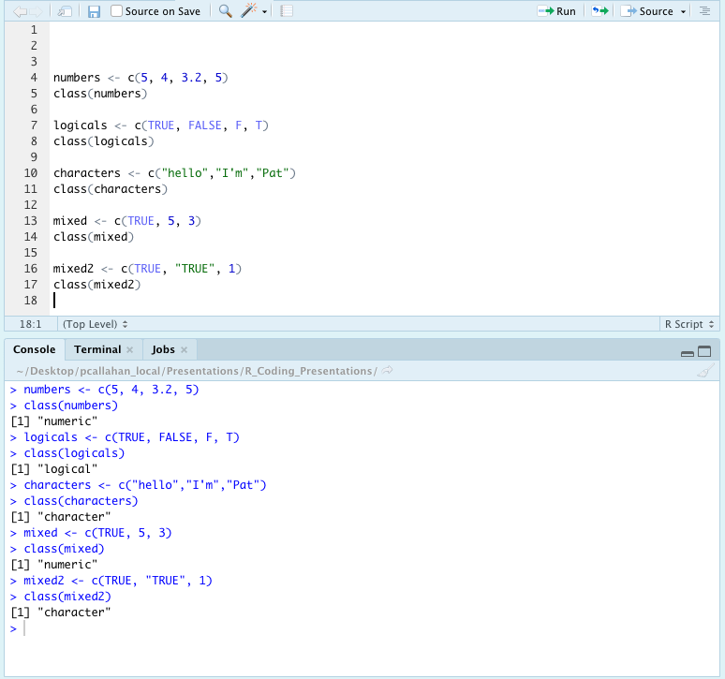
Atomic Hierarchy in Action
Notes:
Vector creation with c(), and every item in the sequence is separated by a comma
First three examples: everything within the vectors are all the same class, and you’ll see we get the expected results with numerics, logicals, and characters
Note that with the characters vector, I’ve quoted all of the words. This is how you tell R that you’re creating a character out of something
The latter two examples show what happens when you mix classes
First shows that the logical, the TRUE, is coerced a level up to numeric
The second example is a bit of a trick question. It shows that, because something is quoted it’s a character, and thus the entire vector is treated as a character

Slide 28
Factors
Often have a similar appearance to characters
Ex: c(“easy”, ”medium”,”hard”) are natively characters, but can be changed to factors
Store data in ordered levels
Declare with factor(x), and argument levels = …
R will use alphanumeric order if levels is unspecified
Why use factors?
Group analysis, function requirement, etc.
Notes:
Factors are closely related to the discussion of atomic hierarchy
They will usually look just like characters!
Example
Factors let you store data in ordered levels and you can declare factors with the factor() function, and specify levels
If you don’t specify, R will just guess by ordering everything based on alphanumeric value
Why care about factors?
Because you need to use factors for most group analysis functions or, for example, plotting data or results by different disease cohorts.

Slide 29
Factors
Factors contain levels represented by digits
*Underlying data structure is an integer!*
Help and troubleshooting
Base R: factor(), ordered(), and relevel() for help
{forcats} package, my recommendation
Notes:
More important information about factors
So factor levels are represented by numbers under the hood
Underlying structure is an integer, so you can actually manipulate factors by number rather than by their name
I note this not because you should, but because it’s something you might do on accident or not understand
Factors are kind of complicated at first so I really recommend that you spend some more time reading on this topic by looking at these functions and packages

Slide 30
Checking Classes
Will often need to check classes and convert between classes
Check classes
Class()
Is.factor(), is.numeric(), is.character(), as.logical(), as.date(), …
Change classes
factor(), as.numeric(), as.character(), is.logical(), is.date(), …
Notes:
So I’ve told you what the major classes are, and a bit how they function
What you’ll need to do most commonly is check classes or change classes of objects
A bunch of helpful functions are included here

Slide 31
Functions
Notes:
Let’s talk very briefly about functions

Slide 32
Functions
In general, you supply an object and a set of arguments
Object is typically a vector or dataframe
Arguments should be named explicitly
R accepts positional and partial matching, however
User-defined and built-in functions
Notes:
Just going to give an overview of how functions are structured in R, and how you use them. There are millions of functions, and I can’t teach you all of them
In general, R is designed as a functional language where a function is named, and you can specify an object argument within the body of the function
Object is normally a vector or a data frame
Arguments should be named explicitly when you first start using R.
That is, if a function has a placeholder for an argument called na.rm that is a logical removing NA/missing values, then you should write na.rm = TRUE, for example
These ideas stand true for both user-defined and built-in functions!
The functions authored by others are just like any custom functions you would write on your own

Slide 33
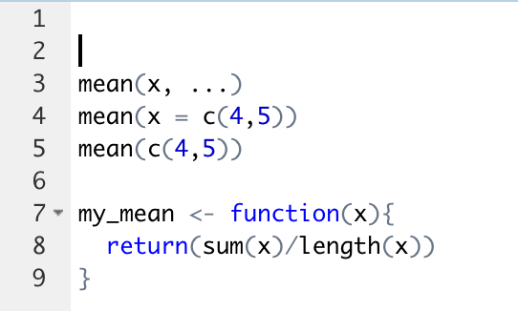
Functions Example
Notes:
R has a built-in function for finding the mean, and the first argument, X, is a placeholder for the values you’re evaluating for the mean.
The … represents space for other arguments that can be specified in this function such as trimming the decimals in the output and removing missing values when calculating
The third call is an example of positional matchibng; the first argument should be a vector of values, and I gave the first spot a vector of values without being explicit
Not going to go into the details, but here’s an example of a user-defined function that is assigned to the variable my_mean.
Uses the function() call and curly braces to wrap everything that will be done in my function, and the output will be returned.
Too much to cover here, but wanted to give an idea

Slide 34
For Loops

Slide 35
For-Loops
Can use for loops for iterative processes and code execution
However, R is already a vectorized language
Objects are stored as vectors, and functions know to look at each i in the sequence
Avoid for loops!
Comprehension
Speed, speed, speed
Notes:
R, like any other language, has for loops where you can iteratively generate values or perform an action
R is already a vectorized language which is unique when it comes to coding languages!
What this means is that objects are stored as vectors, and functions know to look for the i-th element in object’s sequence
For loops are difficult to read especially if you nest them, and they’re super slow
I have never needed to write a for-loop statement, and you should do your best to avoid them
Look to the tidyverse or other statistics packages before you start doing this. I can almost guarantee someone has already written a more efficient and well-documented function for your purpose

Slide 36
Data Frames

Slide 37
Data Frames
Tabular data representation
Familiar a la CSV, XLSX files
Generic term for data in a 2D format
Rows = observations, columns = variables
3 major implementations:
{base}, {data.table}, and {tibble}
Notes:
A data frame is the data structure you all will interface with most commonly, and it’s just another term for tabular data that you might see in a CSV or Excel file
Generic for a 2D format where each row should be an observation and each column should be a variable
There are 3 major implementations of data frames
{base} where they’re referred to as data frames
The {data.table} package where, unsurprisingly, they’re called data tables
And finally the {tibble} package which is part of the {Tidyverse} packages I covered last week. Like the {data.table} package, the {tibble} package names its tabular data as tibbles
At the end of the day, all three of these are pretty much exactly the same, and basically all functions that work with one work with the other.
Tibble is the best one, however, and you’ll see how next

Slide 38
Tibbles
Base R data frame structure
Slow
Printing method (ugly)
Data.table
Fast
Still ugly
Tibbles
Simultaneously data frame, data table, and tibble
Designed to work with {tidyverse}
Superior print method
Notes:
Base R data frames are slowish and ugly to look at in the console
Data tables from the data.table package made explicitly to be fast, but still looks ugly
Tibbles are simultaneously a tibble, data frame, and data table to ensure compatibility everywhere
They’re designed as part of the tidyverse ethos, and they have a superior print method
Print methods may not be something you think about frequently, or may even be wondering what I’m talking about. Let me show you…

Slide 39
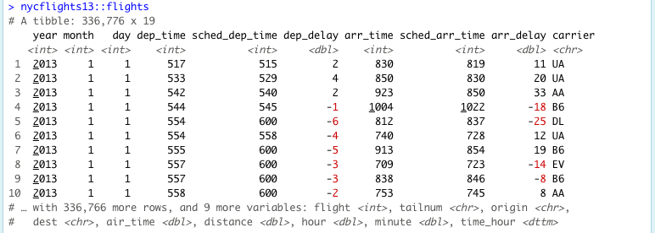
Tibbles
Notes:
Here is what a tibble print-out looks like from a dataset of new york city flights
As you can see, the tibble shows us a bunch of column names, the class of each column, and highlights in red missing or negative observations.
Moreover, it makes a lot of additional information readily available about the dataset as a whole including the additional variable names, and the number of remaining rows
If you read-in your data using the readr or readxl packages from the Tidyverse, your data will automatically be a tibble

Slide 40
Miscellaneous Tips and Tricks

Slide 41
Exploration Tools
Look at your table in Excel or using View()
Quantitative information
str()
summary()

Slide 42
Help! (I need somebody!)
?foo or help(foo)
?foo or help(foo)
?foo or help(foo)

Slide 43
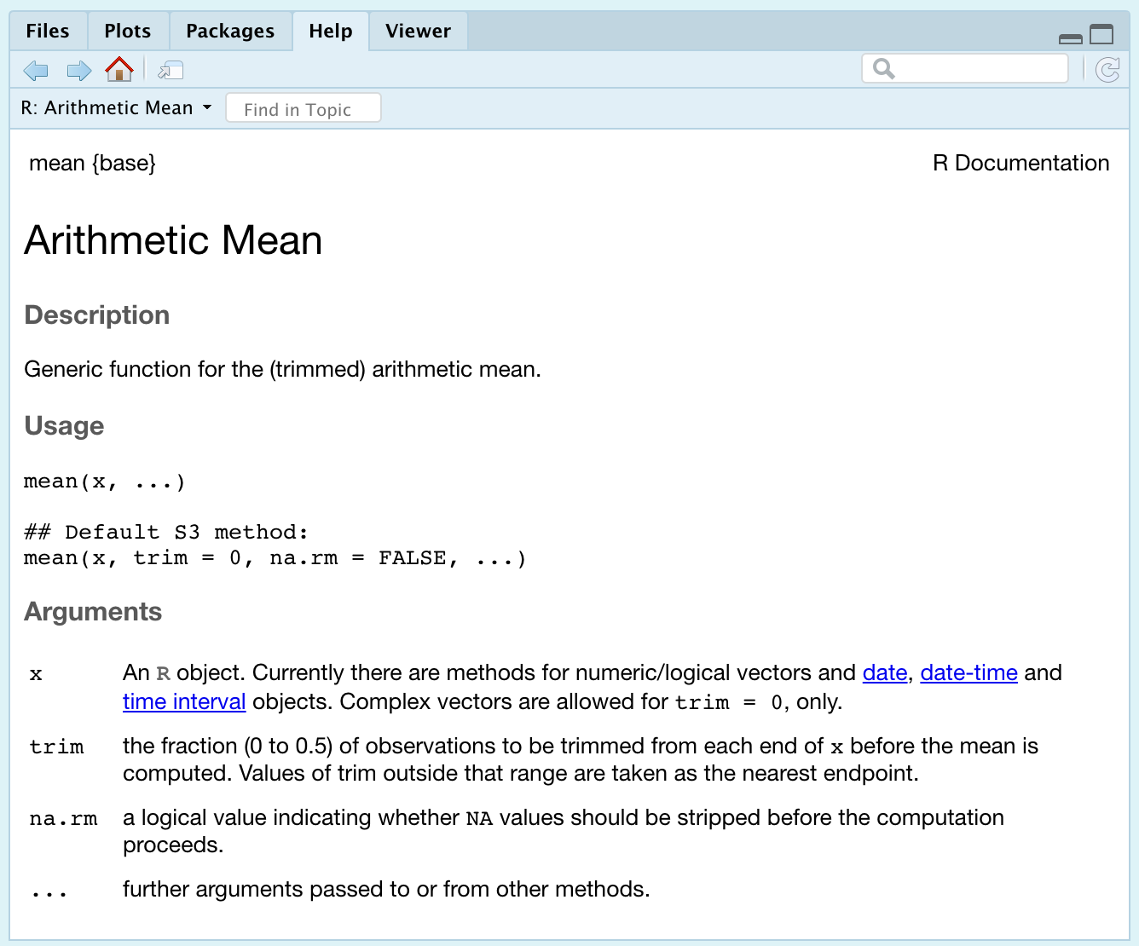
Help! Example

Slide 44
More Help!
Vignette()
Google
Stack Overflow + RStudio Community
GitHub (tread lightly)

Slide 45
Troubleshooting Cheats
Package conflicts/masks
Declare packages with their functions
Ex: filter() or filter()
Too many objects in the environment to keep track of
Useful cleaning functions
rm( list=ls() )
.rs.restartR()

Slide 46
Recommended Resources
Online:
Roger Peng and John Leek on Coursera
DataCamp (free and paid options)
https://homerhanumat.github.io/r-notes/index.html
Books:
Beyond Spreadsheets with R
R in Action
In R:
swirl()
RStudio cheatsheets

Slide 47
Questions?
Slides available on my GitHub, NeuroShepherd, in the R_Coding_Presentations folder
Video recording from today’s session will be posted

